Slide 1
DTMS Capabilities
Information captured in this PowerPoint, to include attached PDFs is
For
Official Use Only

Slide 2
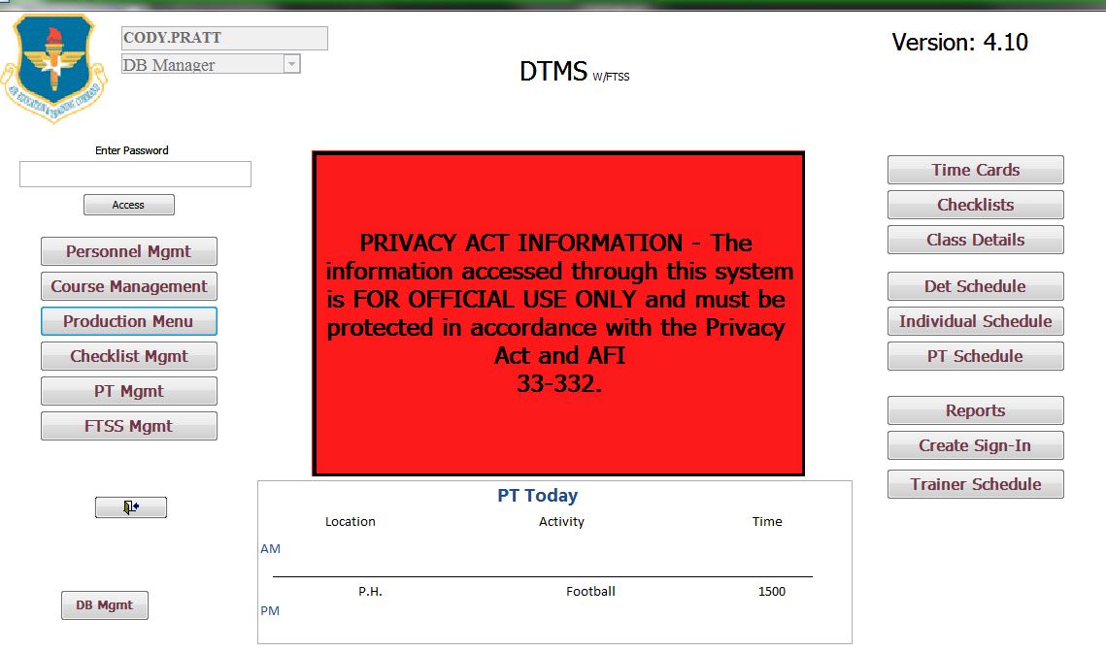
DTMS Capabilities

Slide 3
DTMS w/FTSS Overview
DTMS is a one stop shop for scheduling, production, and every instructor.
With FTSS Integration, provides a streamlined process from MTFs requesting courses via the electronic 898 process, to end of month production metrics produced at squadron and group levels.
Timeline for one course taught at a detachment
Scheduling reviews 898 requests in FTSS via DTMS
Scheduling plugs in courses to instructor schedules
Scheduling uploads course into FTSS
Scheduling retrieves TTMS class number from FTSS, DTMS updates
Instructor begins class in DTMS, fills in student information
Instructor fills out their time card for every day of hours taught
Production tracks the course 325 routing via the DTMS 325 tracker
Production uses information filled out in time cards to produce end of month production metrics and upload them into FTSS

Slide 4
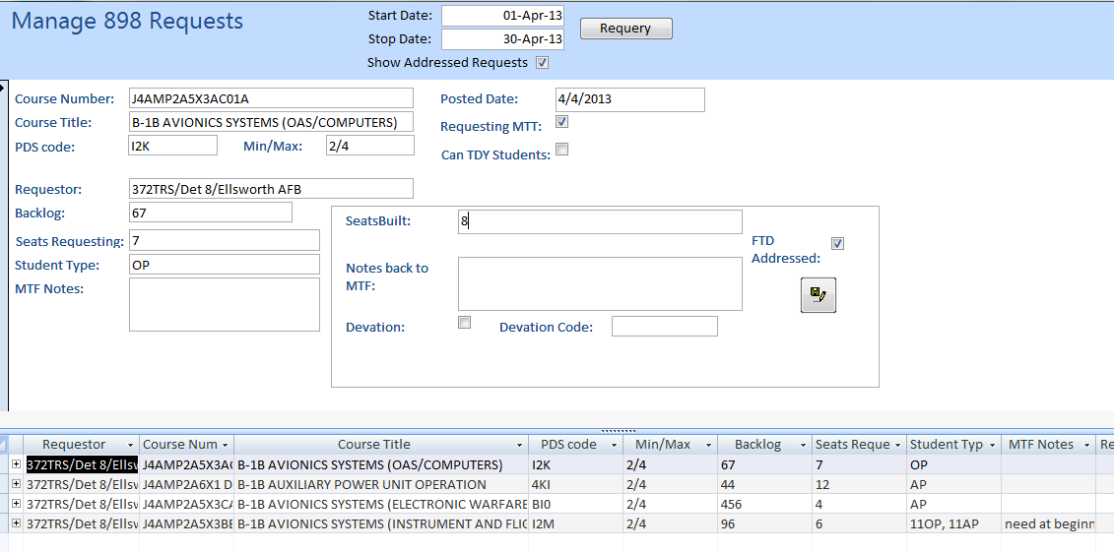
Scheduling
This portion requires your MTF to utilize the MTF FTSS interface available on the FTSS website.
In Trial/Debug Stage
Scheduling reviews 898 requests in FTSS via DTMS

Slide 5
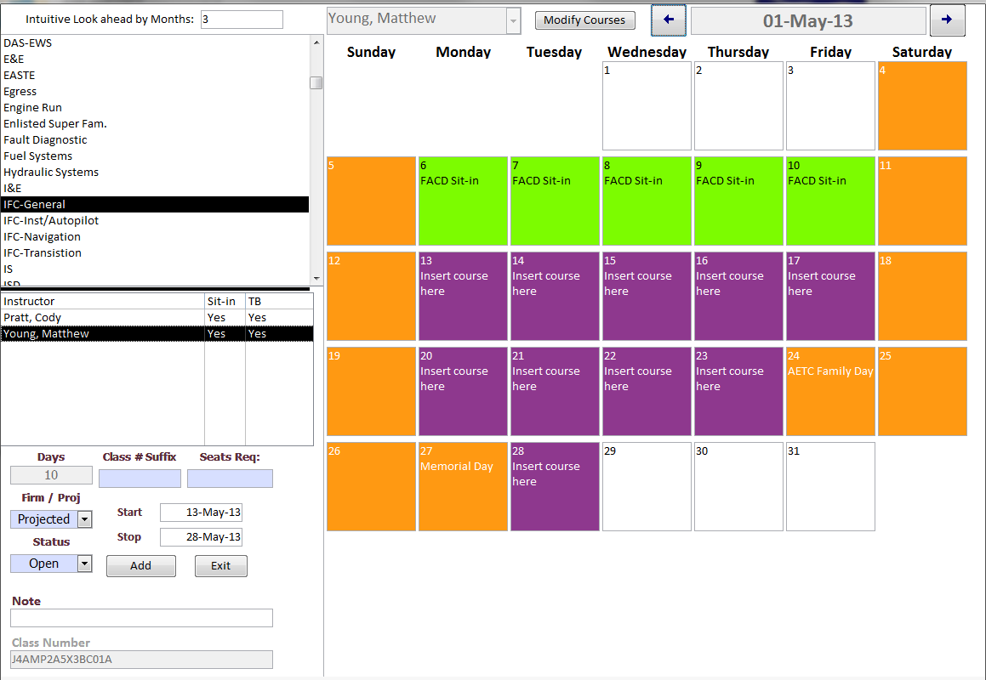
Scheduling
2. Scheduling plugs in courses requested on 898 into instructor’s schedule.

Slide 6
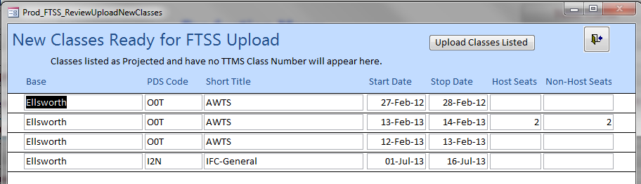
Scheduling
3. Scheduling uploads course into FTSS with one button in Production Menu.

Slide 7
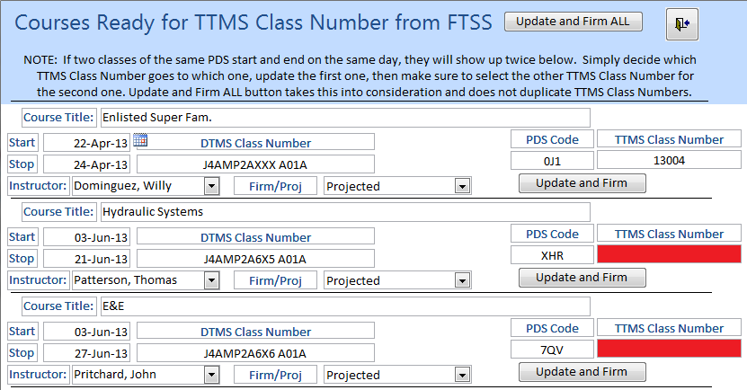
Scheduling
4. Scheduling retrieves TTMS class number from FTSS, updates DTMS.

Slide 8
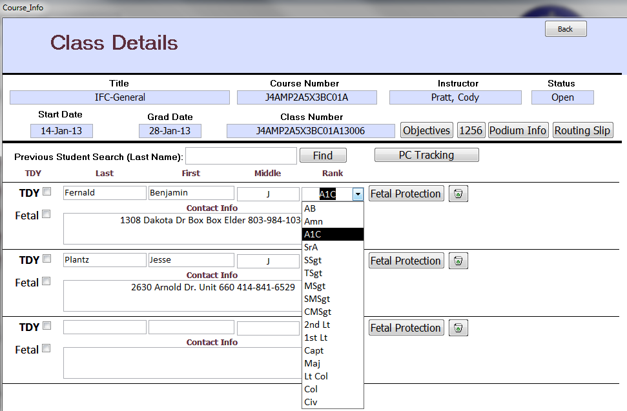
Instructors
5. Instructor begins class in DTMS, fills in student information.
667A and 1256 certificates are auto-generated in DTMS.
Student rank here is later used to produce AP, OP, or CP
numbers for production.

Slide 9
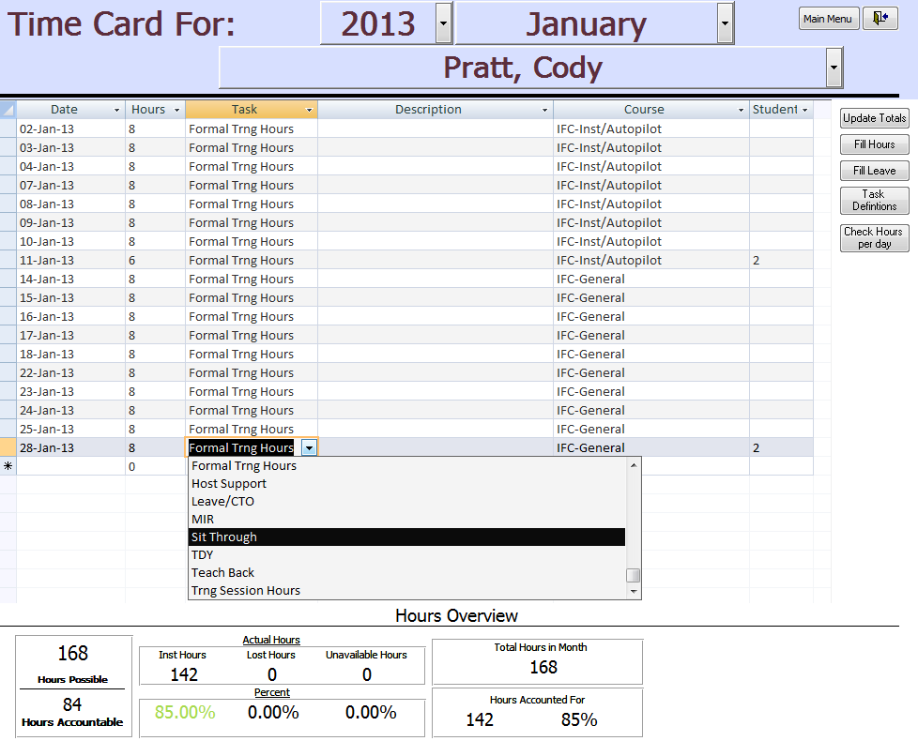
Instructors
6. Instructor fills out their time card for every day of hours taught.
These numbers are used for production reports such as “How We Spend Our Day”.
Numbers are crunched here so each instructor can see if they’re achieving their 50%.

Slide 10
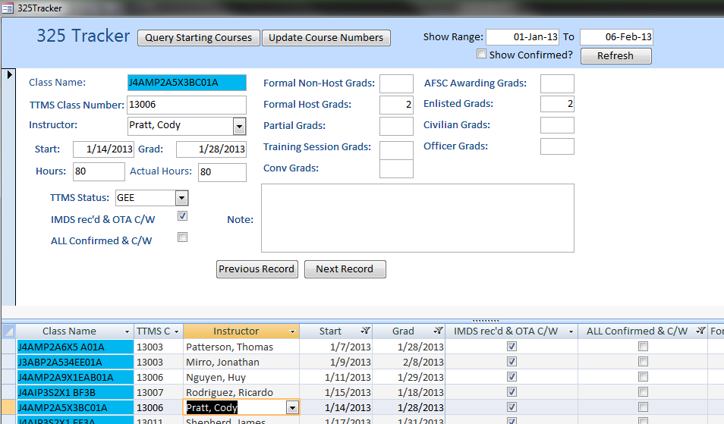
Production
7. Production tracks the course 325 routing via the DTMS 325 tracker.
This table is historical, uses course and instructor input information to produce all production reports.

Slide 11
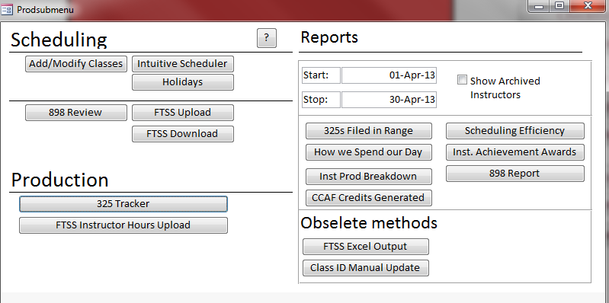
Production
Double click each icon to view the report.
325s Filed in Range
CCAF Credits Generated
How We Spend Our Day
Scheduling Efficiency
Instructor Production Breakdown

Slide 12
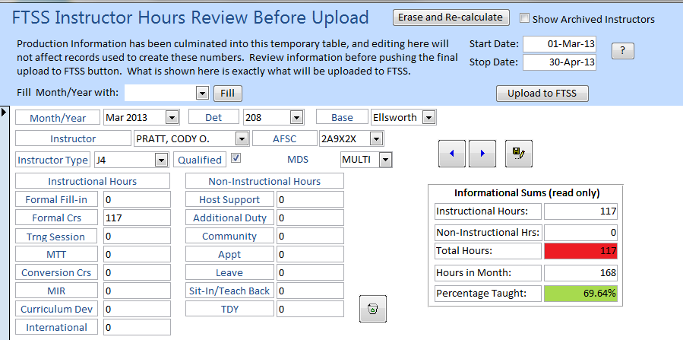
Production
Production uses information filled out in time cards to produce end of month production metrics and upload them into FTSS.

Slide 13
DTMS Capabilities
DTMS has several other capabilities concerning detachment level administration and management not related to scheduling and production. Below is the short list.
Instructor qualifications, internship tracking, Faculty Development Course Tracking.
281 & SMT tracking
Award tracking
Checklist creator
EPR & Dec due dates
POI review date tracking
CCAF completion tracking
PT schedule and attendance tracking
Trainer schedule
FTSS information management

Slide 14
DTMS Goals
Directly link DTMS with FTSS sharepoint lists for Scheduling
Directly link DTMS with FTSS sharepoint lists for Production Metrics
Create Electronic 898 Process for MTF and provide interface, link DTMS to process as well.
Scheduling link complete
Production link complete
Electronic 898 Process created, in trial stage

